Slide 1
Virginia Land Conservation Foundation
FY23 Grant Round
Grant Workshop

Slide 2
VLCF Workshop Agenda
1:00 PM Overview of VLCF Grant Application Requirements & Additional Scoring Criteria
Suzan Bulbulkaya, Dept. of Conservation & Recreation
1:15 PM Farmland Preservation Category
Brady Deal, Office of Farmland Preservation,
Dept. of Agriculture & Consumer Services
1:30 PM Forest Preservation Category
Karl Didier, Forestland Conservation Program, Dept. of Forestry
1:45 PM Historic Resources Category
Karri Richardson, Division of Preservation Incentives,
Dept. of Historic Resources
2:00 PM Natural Areas Category
Rob Evans, Division of Natural Heritage, DCR
2:15 PM Open Space and Parks Category
Kristal McKelvey, Planning & Recreation Resources Div., DCR
2:30 PM Questions from the audience

Slide 3
VLCF Program Information
Record funding available for FY23 land conservation grants: $14.9M
$12M budget + $2.9 M in returned grant funding
Five categories of funding:
$2,400,000 for Farmland Preservation
$2,800,000 for Forestland Preservation
$3,000,000 for Historic Preservation
$3,337,440 for Natural Area Protection
$3,390,000 for Open Spaces and Parks

Slide 4
Program Information
Who can apply?
State & local governmental bodies, Virginia Indian Tribes, and qualified nonprofits (“holder” VA Cons. Easement Act).
Match Requirement:
Applicants can seek up to 50% of a project’s purchase price + due diligence costs, unless a state agency or Virginia Indian Tribe (100%).
Bargain sales (landowner donates a portion of the appraised value of the property)
A list of potential other grant sources:
https://www.dcr.virginia.gov/land-conservation/federal-state-grants
Notes:
Nonprofits must meet “holder” requirements in the Conservation Easement Act
At least 1/2 of the funding must be for projects with public access.
Geographic distribution for a fair allocation throughout the state.
Acquisition costs include purchase price and due diligence costs

Slide 5
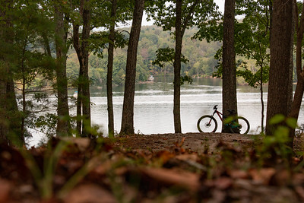
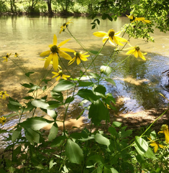
General Program Requirements
Project must protect a specific site, with the parcels clearly identified in the application.
Project should be completed within TWO YEARS; a one-year extension may be granted.
Projects by nonprofits must have an open-space easement held by a public body.

Slide 6
Grant Manual & Application
Please note the important information in the Appendices:
A: Checklist of Required Items for a Complete Application
B: Scoring Sheets for five Categories & Additional Scoring Criteria
C: Example Match letter
D: Required Property Protections and Riparian Buffer Info
Submit your application via email, in one searchable PDF file.
Files larger than 20 MB require an extra step: contact Larry.Mikkelson@dcr.Virginia.gov by Aug. 29, to receive instructions to upload your digital application to the state’s large file transfer platform.
Applications are due by 4 p.m. on September 6, 2022.
Notes:
Note: we will help applicants with their applications if submitted at least two weeks in advance of due date.

Slide 7
Grant Application Scoring
Interagency Taskforce:
Dept. of Ag. & Consumer Services
Dept. of Forestry
Dept. of Historic Resources
Dept. of Conservation & Rec.
Natural Heritage
Planning & Rec. Resources
Dept. of Wildlife Resources
Virginia Outdoors Foundation
Each category: 100 points
Additional Scoring: 72 points
Choose a secondary category and be sure to include information about how the project supports this category in your application (May be critical to receive funding if none is available in the primary category)
Be sure to address all criteria!

Slide 8
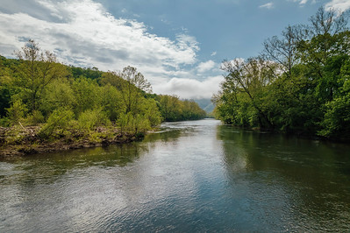
Grant Application Scoring, con’t.
SCORE your application! (Be sure all pertinent info is included in your application to get all of the points)
*All resource protections stated in the application that receive points must be included in the project’s final deed language.*
Eg., promised 100-foot riparian buffers that are forested get extra points and must be protected in perpetuity.

Slide 9
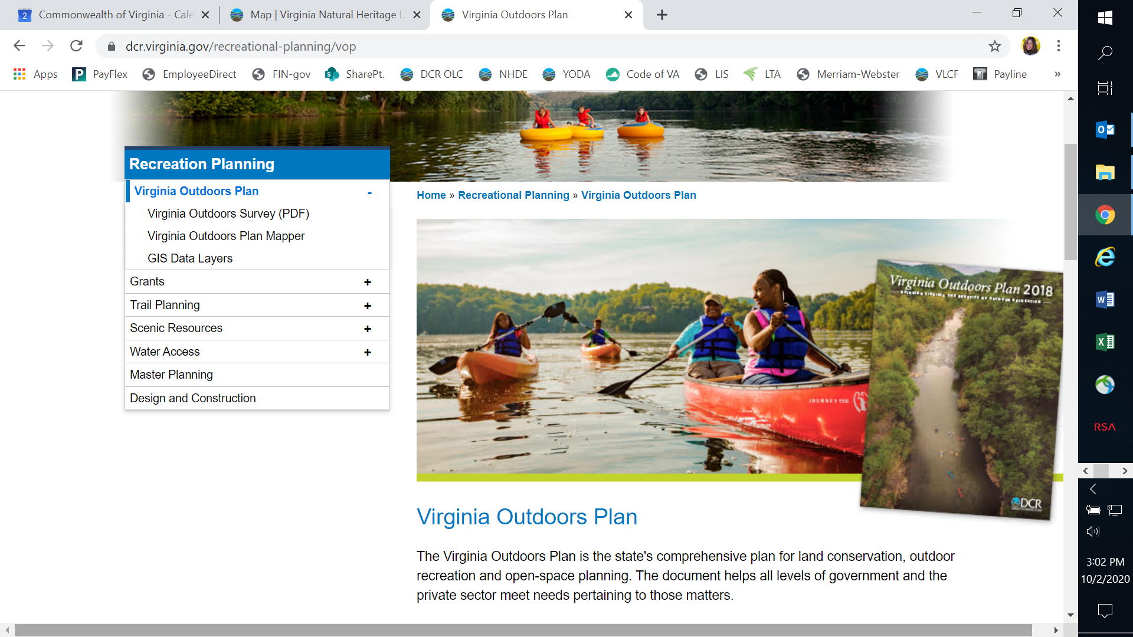
Additional Scoring Criteria – see pages 13 and 29 of the Grant Manual
1. VOP Identified Need - Does the project provide resource conservation needs as identified in the Virginia Outdoors Plan or a local comprehensive plan?
Find the VOP at: www.dcr.virginia.gov/recreational_planning/vop.shtml

Slide 10
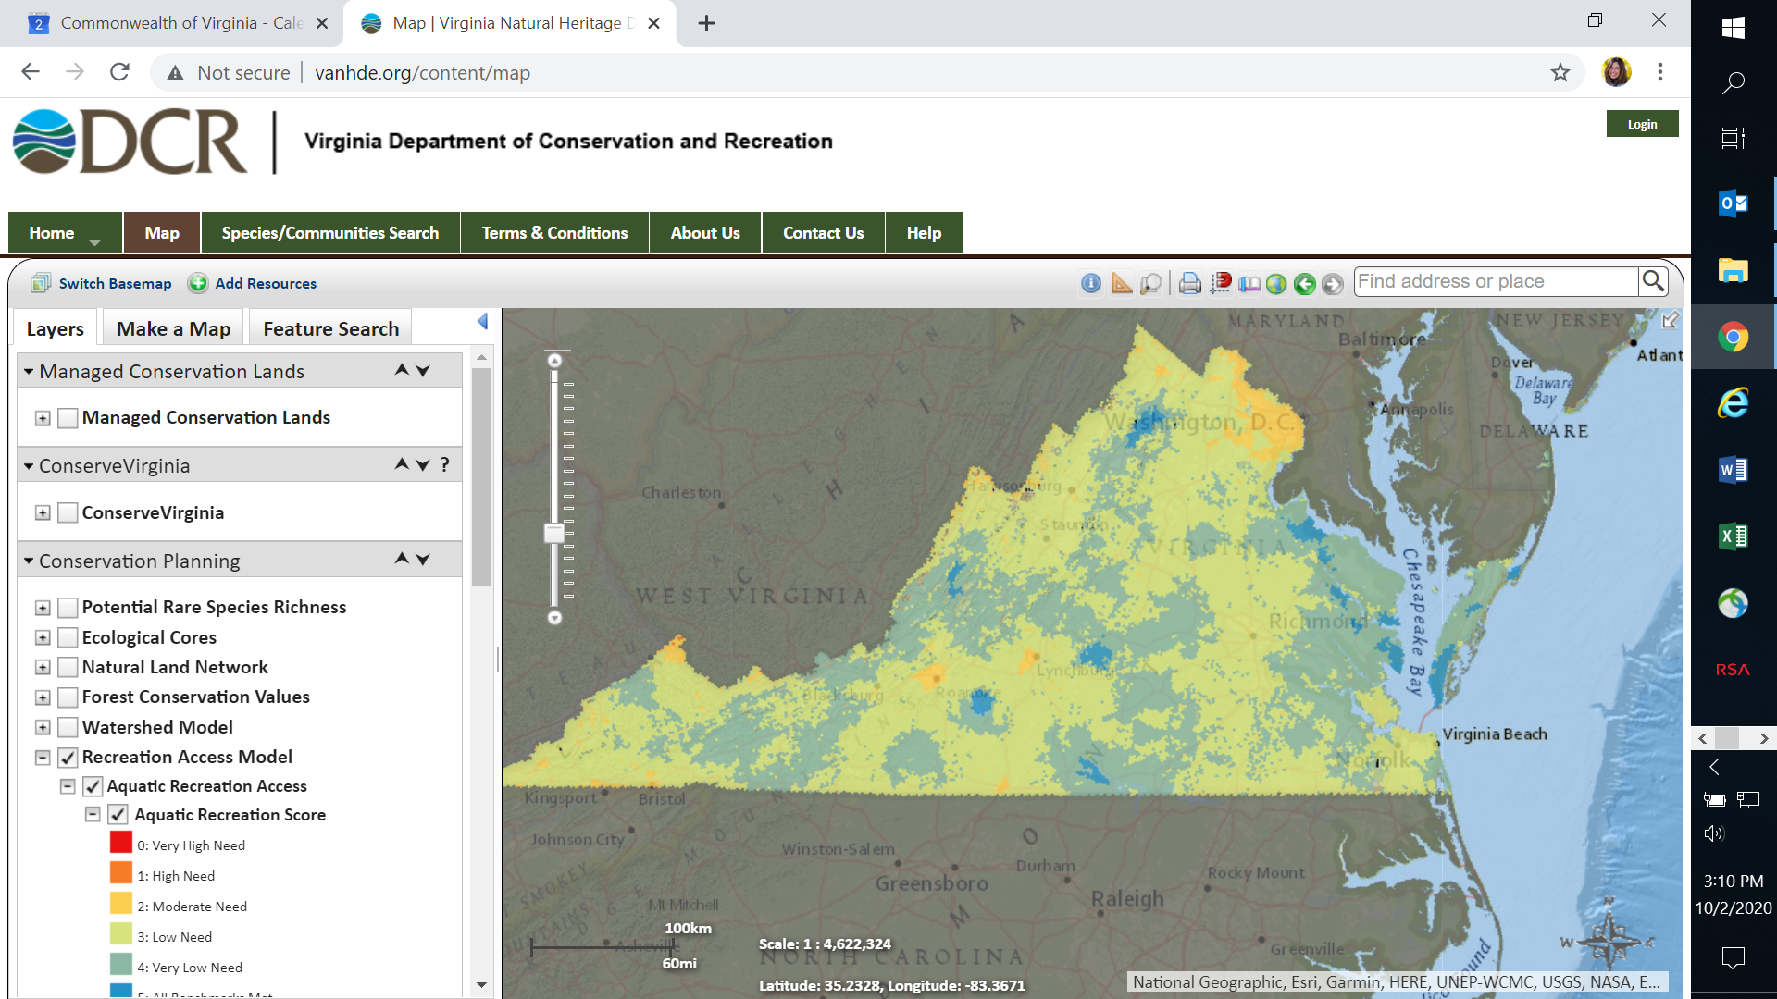
2. Virginia Nature Based Recreation Access Model Identified Need - For parcels that will provide public access, does the project demonstrate a need for land or water access based on the Nature Based Recreation Access Model?
Find the Rec Access Model at: https://vanhde.org/

Slide 11
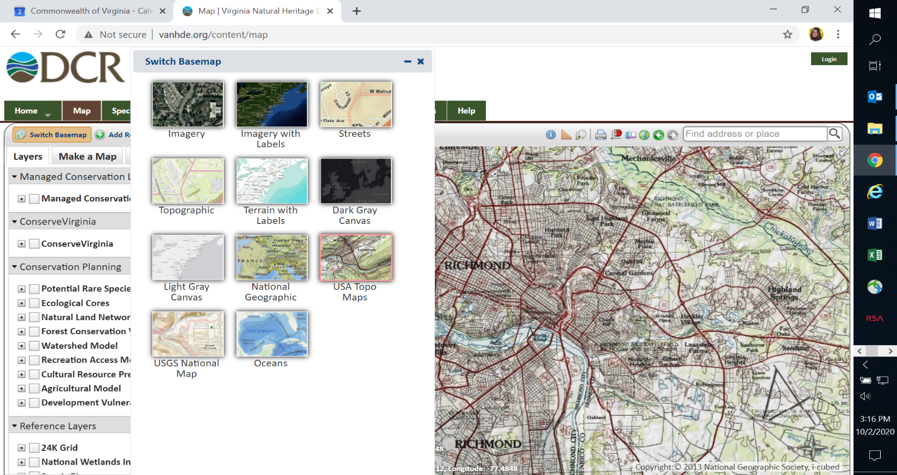
3. Water Quality Benefit - Does the project protect water quality beyond the minimum 35’-wide permanent vegetated riparian buffer on perennial streams, rivers, shorelines, and waterbodies with perennial outflow?
Find USA Topo maps at: https://vanhde.org/

Slide 12
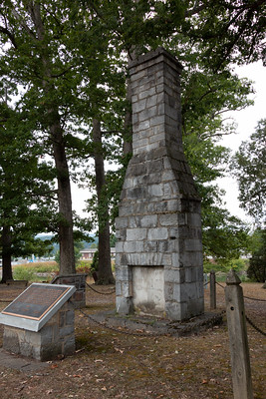
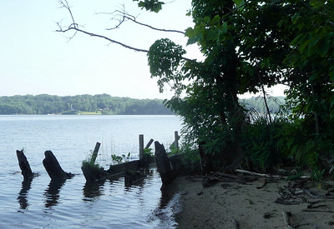
4. Protection of Cultural Resources - Is there a local cultural resource on the property that will be protected by this project?
Examples include: remnants of prior settlements or burial sites of enslaved or indigenous people, former segregated schoolhouses, or sites of early racial integration, historic roadbeds or railbed systems.
Provide photos and documentation. Tell us about the cultural importance of the site and how it will be protected.
Provide educational opportunities open to the public.

Slide 13
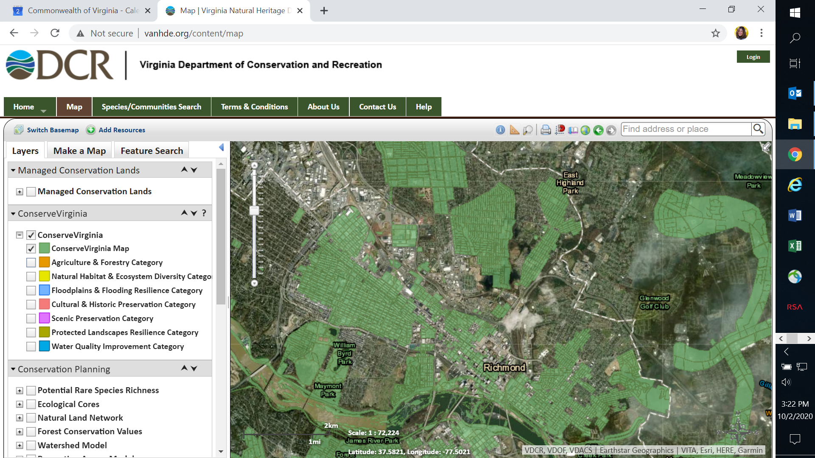
5. Additional ConserveVirginia Values - Does the project protect additional ConserveVirginia values in perpetuity?
Find ConserveVirginia at: https://vanhde.org/
Any questions: Gina DiCicco Land Conservation Specialist VA DCR (804) 837-1819
Gina.Dicicco@dcr.virginia.gov

Slide 14
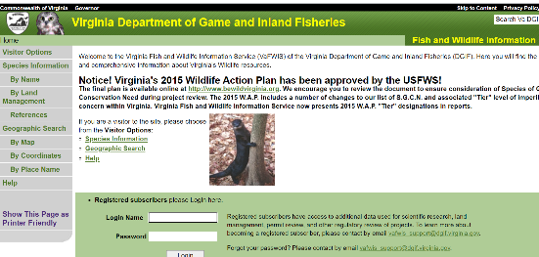
6. Wildlife Value - Does the project benefit wildlife, habitat, and human/wildlife interaction? Max. 10 points.
Identify wildlife presence = 1 point; if DWR Species of Greatest Conservation Need or State or Federally listed T&E is present = additional 3 points
Protect wildlife habitat = 1 point; If DWR Species of Greatest Conservation Need or State or Federally listed T&E is protected = additional 4 points
Public access to view, hunt, or fish wildlife = 1 point
https://vafwis.dgif.virginia.gov/fwis/
Any questions:
Becky Gwynn, Deputy Director
Va Dept. of Wildlife Resources
Becky.Gwynn@dwr.virginia.gov
(804) 593-2043

Slide 15
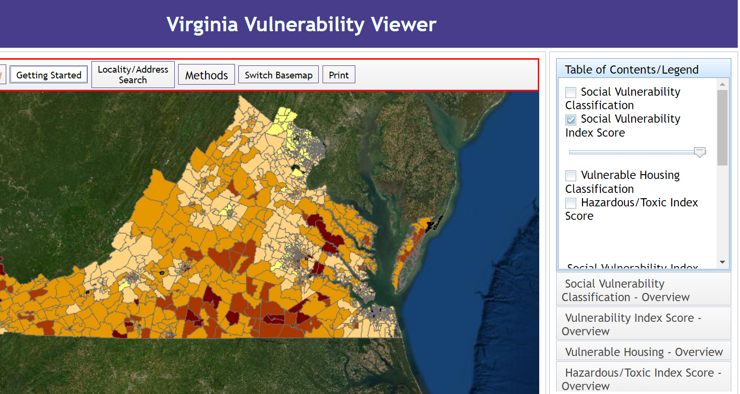

7. Public Access - Does the project provide public or visual access?
8. Underserved Communities – Does the project benefit an underserved or socially vulnerable community? VIMS Social Vulnerability Index : http://cmap2.vims.edu/SocialVulnerability/SocioVul_SS.html
9. Ratio of Match to Total Project Cost – Is the applicant providing 60% or more of the funding and did they include an appraisal?

Slide 16
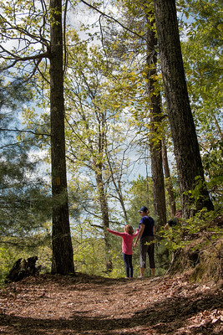

VLCF Grant Manual & Application:
https://www.dcr.virginia.gov/land-conservation/vlcf
Questions?
suzan.bulbulkaya@dcr.virginia.gov
(804) 371-5218
larry.mikkelson@dcr.virginia.gov
(804) 337-0046
gina.dicicco@dcr.virginia.gov
(804) 837-1819

