Slide 1
Farmlands Category
VLCF Grants Workshop
August 8, 2022

Slide 2
Farmlands Criteria
Total of 100 points
Category I: Land Evaluation – 40 points
Category II: Land Use – 40 points
Category III: ConserveVirginia – 20 points

Slide 3
Land Evaluation Soils (25 pts)
Soils should support agricultural uses
More points for prime, unique and statewide importance

Slide 4
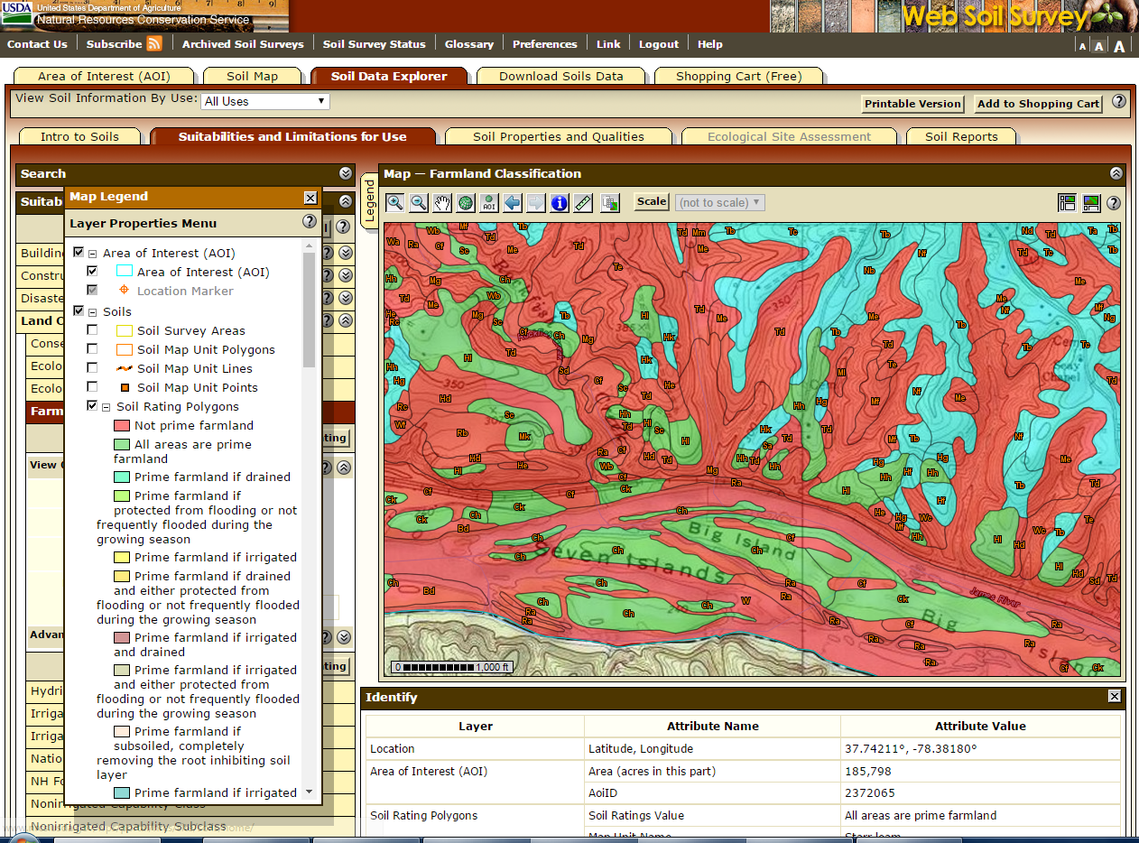
https://websoilsurvey.sc.egov.usda.gov/
Notes:
Soil quality - major determining factor- Parcel ranked on soil types it contains:
1. “Prime farmland” is land that has the best combination of physical and chemical characteristics for producing food, feed, fiber, forage, oilseed, nursery, and other agricultural crops with minimum inputs of fuel, fertilizer, pesticides, and labor, and without intolerable soil erosion. Prime farmland includes land that possesses the above characteristics but is being used currently to produce livestock and timber. It does not include land already in or committed to urban development or water storage.
2. “Unique farmland” is land other than prime farmland that is used for production of specific high-value food and fiber crops, as determined by the United States Secretary of Agriculture. It has the special combination of soil quality, location, growing season, and moisture supply needed to economically produce sustained high quality or high yields of specific crops when treated and managed according to acceptable farming methods.
3. “Important farmland” other than prime or unique farmland is land that is of statewide or local importance for the production of food, feed, fiber, forage, nursery, oilseed or other agricultural crops, as determined by the appropriate state agency or local government agency, either or both, and that the United States Secretary of Agriculture determines should be considered as farmland for the purposes of this chapter

Slide 5
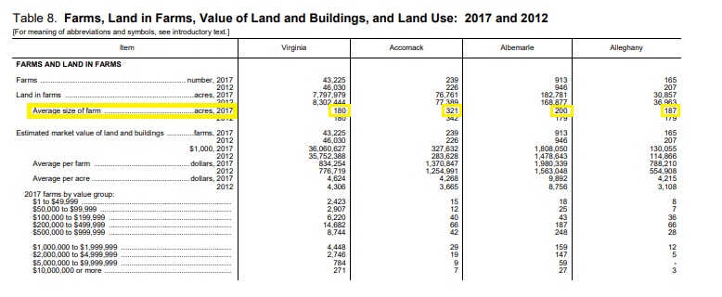
Land Evaluation Average Size of Farm (15 pts)
Latest US Census of Agriculture (2017)
https://www.agcensus.usda.gov/Publications/AgCensus/2017/

Slide 6
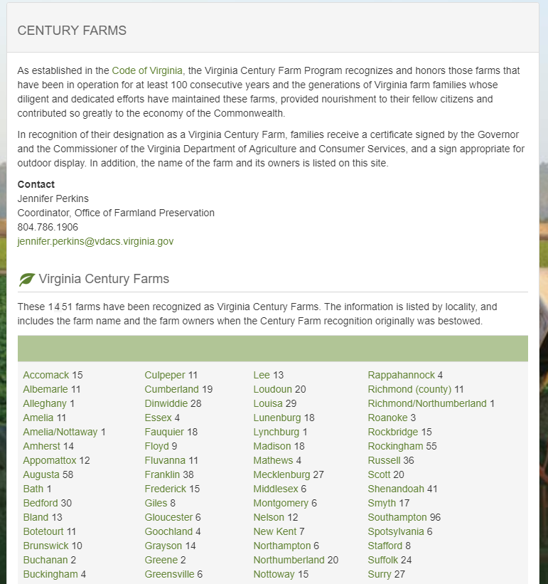
Land Use Current and historical use of property (8 pts)
Is the land currently being farmed?
Is this a Century Farm?
http://www.vdacs.virginia.gov/conservation-and-environmental-virginia-century-farms.shtml
Notes:
1) Is the land currently being farmed; 2) is this a Century Farm? Maximum score 8 points

Slide 7
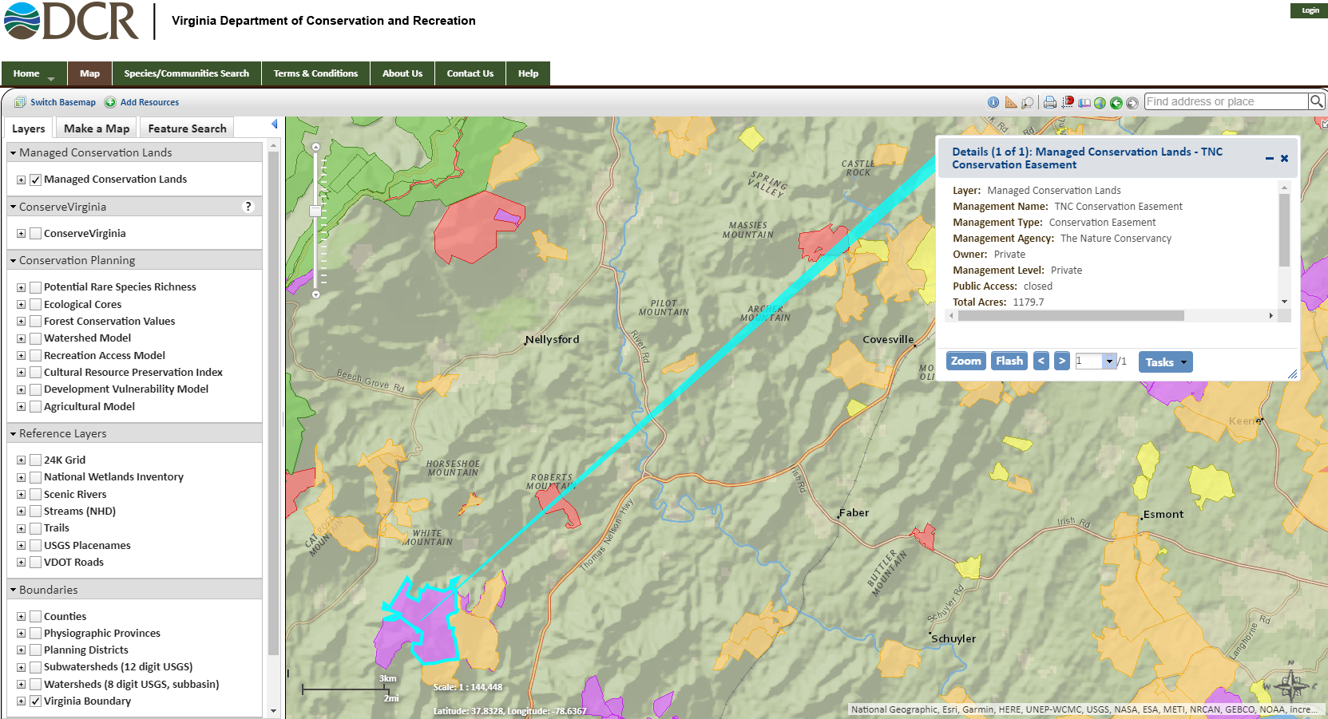
Land Use Proximity to other preserved lands (10 pts)
https://vanhde.org/content/map
Notes:
To what degree is the land adjacent to or in close proximity to other preserved lands, either in agriculture production or non-active in farming? Maximum score 10 points

Slide 8
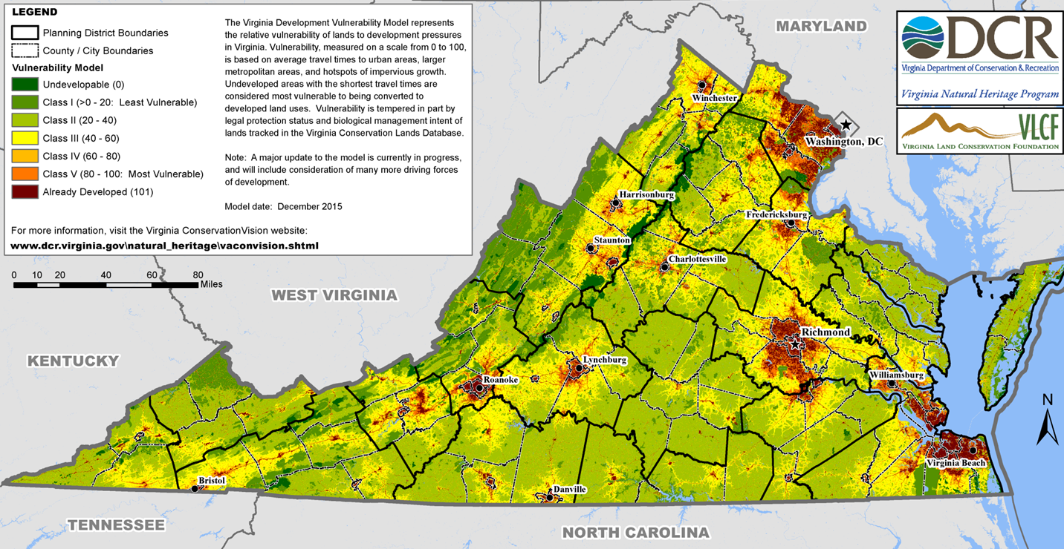
Land Use Vulnerability ranking (8 pts)
2 points for each ranking from Class II to Class V
ConservationVision Development Vulnerability Model
More development pressure = more points
https://vanhde.org/content/map

Slide 9
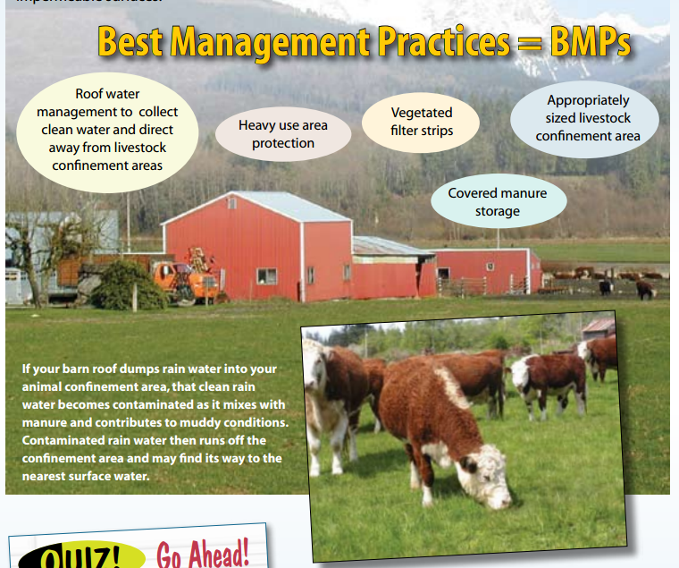
Land Use Implementation of farm BMPs (10 pts)
Points for both voluntary Best Management Practices and those through a state or federal conservation plan
Additional points awarded for land with conservation plans and/or nutrient management plans

Slide 10
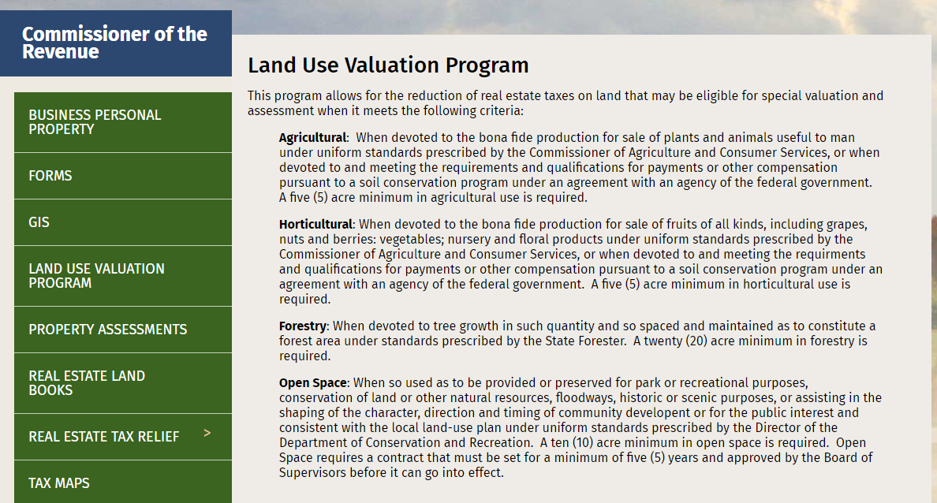
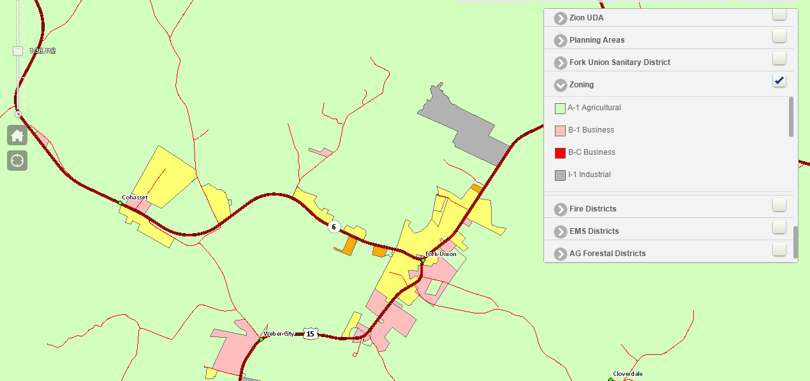
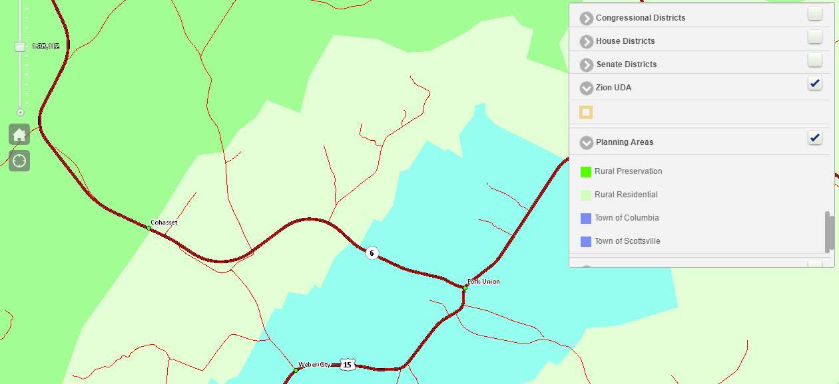
Land Use Supported by local policies (4 pts)
Demonstrated support for farmland protection policies including comprehensive plan, ag zoning, agriculture/forestal districts, and use value taxation
Zoning Map: Agricultural Zoning
Future Land Use Map: Rural Preservation

Slide 11
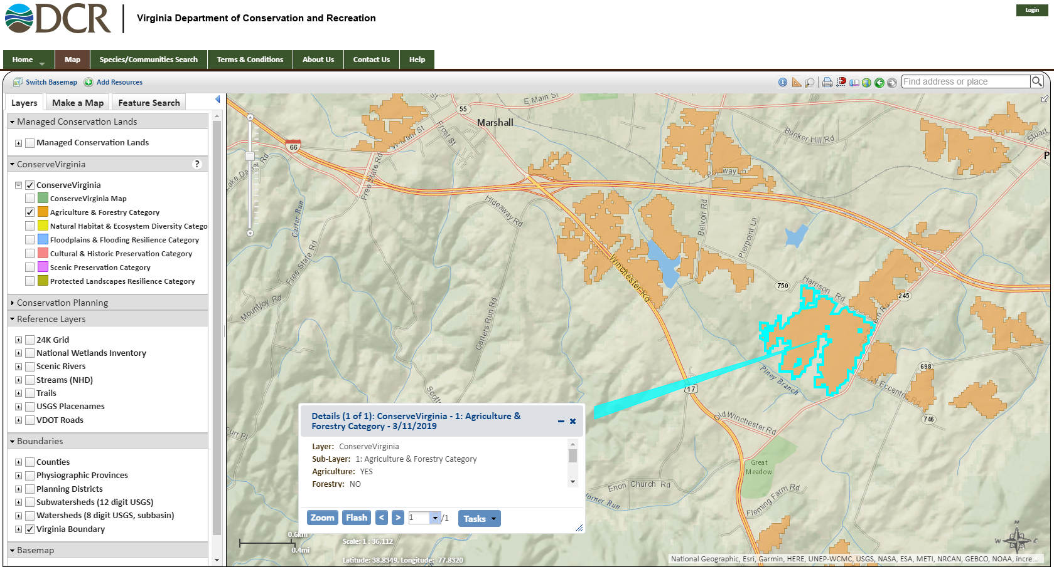
ConserveVirginia Agriculture Layer (20 pts)

Slide 12
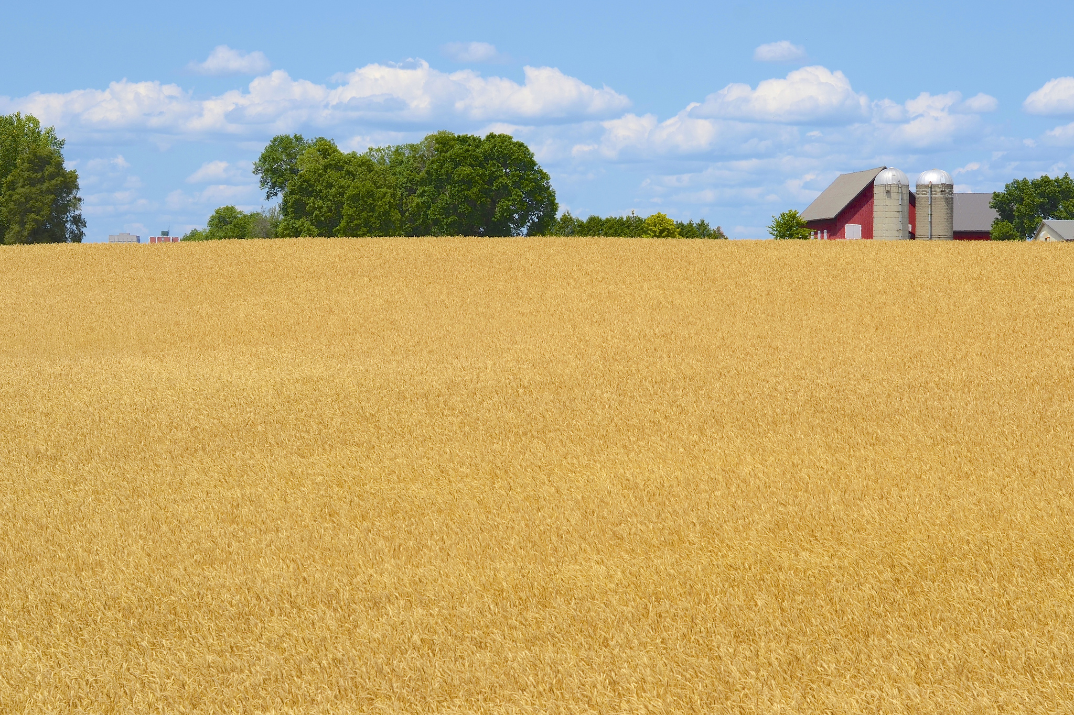
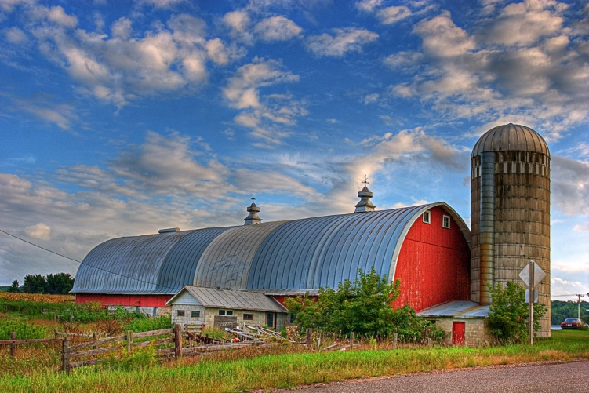
Field
Questions?
Jen Perkins
Office of Farmland Preservation
Va. Dept. of Agriculture & Consumer Services
(804) 786-1906
Jennifer.perkins@vdacs.virginia.gov
template

